Slide 1
Assignment 2 UI/UX analysis on Snapchat
- Vega Shetty

Slide 2

Service selected: Snapchat
Snapchat is a mobile application that allows users to capture videos and images that self destruct after a few seconds.
When a user sends a message they can decide whether the picture/video can last from 1 to 10 seconds.
Setting stories, using geo-filters and Discover news feed are some of the features of Snapchat.
Users can login and add friends by their username ,address book and Snapcode.

Slide 3
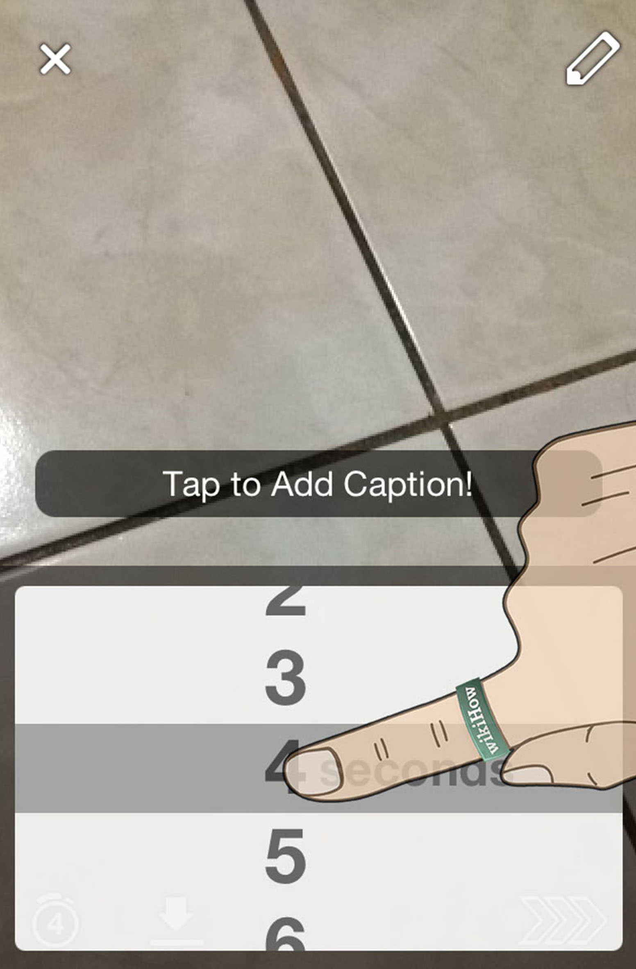
UX aspects that I like:
The option to set a time limit for how long the picture is visible i.e. the temporary nature of sharing pictures and videos is one of the main reasons for Snapchat’s popularity in this social media age. Conversations in Snapchat can be quick and frequent due to this temporary nature of sharing.
- User can add a time limit & caption to the picture

Slide 4

UX aspects that I like:
Integrating geo-filters for pictures based on the location of the user helps make the app more personalized , thereby improving the user experience.

Slide 5
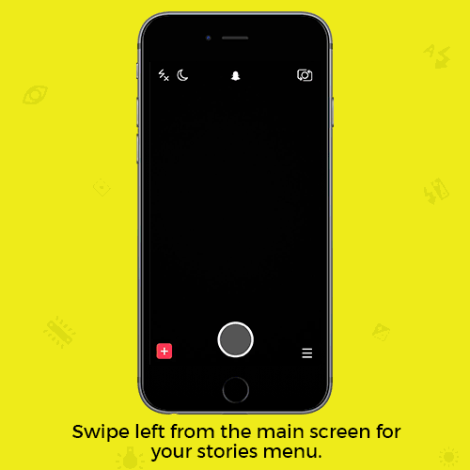
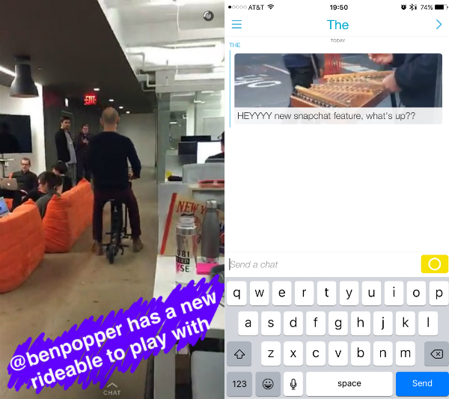
UX aspects that I like:
Snapchat is designed to be friction free i.e when you open the app , the camera is instantly activated and the moment can be captured and sent to a friend in seconds.
Having conversation using visual aids is slowing replacing texting and Snapchat does that using it’s chat feature efficiently.
Aesthetics are appealing (youth-friendly mostly) and discovering features adds an element of surprise and intrigue for users.
Chat feature
lets you reply
to a picture by texting.

Slide 6
Suggestions for improvements
Difficulty in Navigation :
Any first time user on Snapchat is thoroughly confused as to how to navigate through the application. Most first time users do not know the swipe left-right-top features on Snapchat. Since user accessibility is one of the core foundations of UX, Snapchat falls short on it.
Improvement :
One improvement could be by providing a quick tutorial while onboarding a user and how the features of the application work.
Providing a brief description below the icons or glossary of icons could also help first time users to a great extent.
Overhaul :
Navigation can be improved by providing a mini-tab bar at the bottom of the screen, with a icon representing each page with a brief description below the icon.
Since Snapchat’s logo is one of it’s USP’s, it can be present at every page thereby acting as a home logo so that users aren’t confused while navigating to the home screen.

Slide 7
Suggestions for improvements
Lack of clarity / description:
Overall there is a lack of clarity in the application as to how to use the features.
One example would be that there are no guidelines provided as to how to use the face filters on the app. Another example would be how the video and camera are integrated as a single button which is not a conventional choice in any application.
Improvement :-
The application could provide a quick disappearing guide text or picture so that the user can hold the face area to activate the filters. Onboarding is very vital for any new application. Though it is targeted to be a new generation application, providing relevant information regarding features of the application is important.
Overhaul / moonshot :-
Snapchat recently released a Snapchat accessory called Snapchat spectacles which captures video through glasses and streams them on the app. This is certainly something which can replace the video button currently if the accessory gains momentum.

Slide 8
Suggestions for improvements
Lack of usability: The user has to more or less discover features designed for the application on his own. The news feed section of the app is often not known to new users as one has to swipe left twice from home screen to get there.
Improvement : Providing a good navigation flow and structure could help discover features faster.
Lack of good content: Often the news feed is irrelevant to the user and not personalized.
Improvement :This can be improved by giving users an option to select news topics only that they want to see.
Lack of user demographic : The application itself is mostly marketed and designed as an app for the younger generation thereby reducing the demographic and user market to a great extent.
Ambiguity in features: Though Snapchat projects itself as an application that can send & receive photos temporarily, it still allows the receiver to screenshot and save the picture which then sends the notification to the sender.
Improvement : Providing an option to users to allow saving certains pictures/stories is important.

Slide 9
Suggestions for improvements
Lack of standard conventions:
Snapchat doesn’t follow most of the standard conventions seen in a mobile application. A good example of this would be the unconventional location of the settings tab which can be accessed on swiping down the camera screen.
Improvement:
Snapchat in general does not follow the design of most conventional mobile applications but rather allows users to discover features on their own. While maintaining their uniqueness, the application should follow basic conventions followed in app navigation for ease of users.
Overall Snapchat lacks the ease of use/ simplicity which any user expects from an application and has a scope of improvement in the future.

